Slide 1

Introduction to Python

Slide 2
Usage of Python
Data analysis
Web development
Machine learning

Slide 3

Example
What do you think this will do?

Slide 4
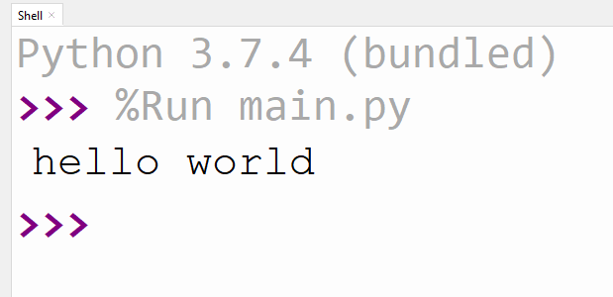
Example

Slide 5
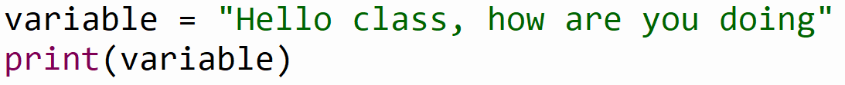
Example
What do you think this will do?

Slide 6
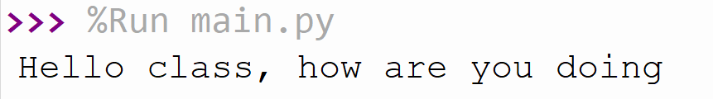
Example

Slide 7
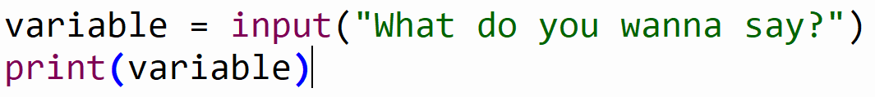
Example
What do you think the input function will do?

Slide 8
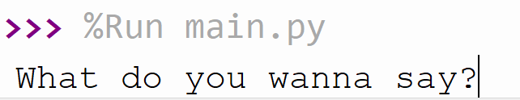
Example

Slide 9
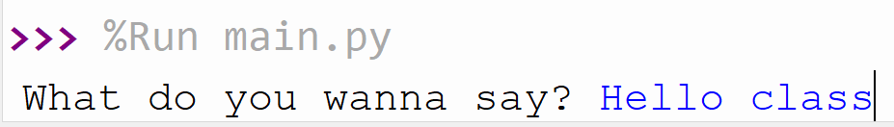
Example

Slide 10
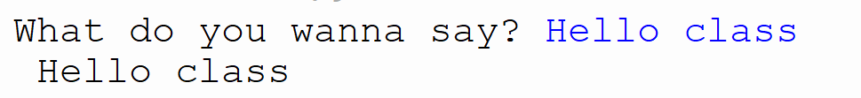
Example

Slide 11
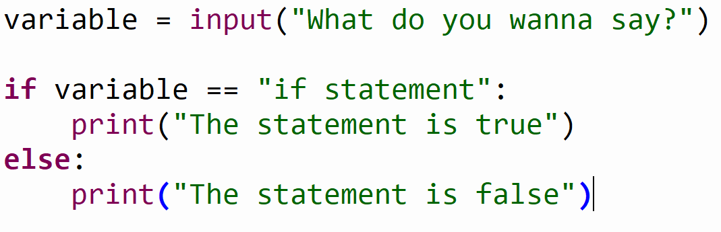
Example
What does the if/else statement do?

Slide 12
Example
What will be printed if variable is “if statement”

Slide 13
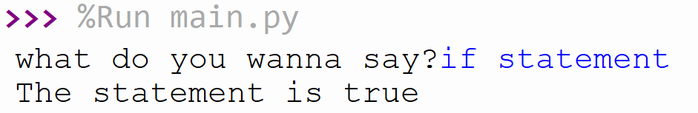
Example

Slide 14
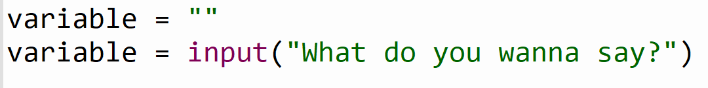
Example
What will happen to the variable?
It will be overwritten by the input

Slide 15
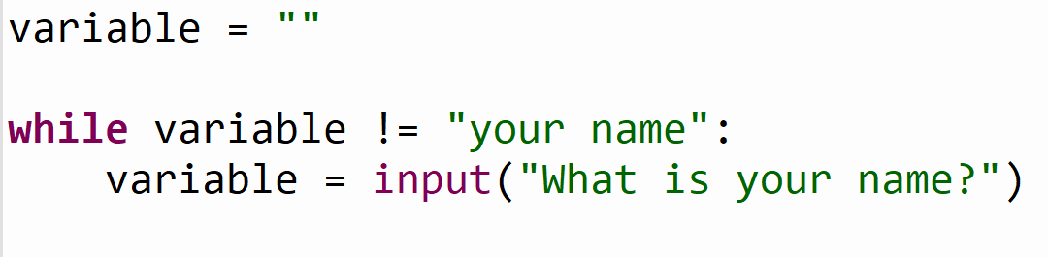
Example
What will the while do?

Slide 16
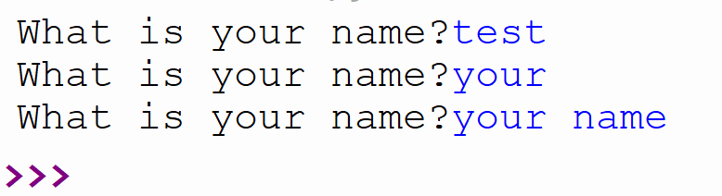
Example

Slide 17

Example
What will happen if we write: hello

Slide 18
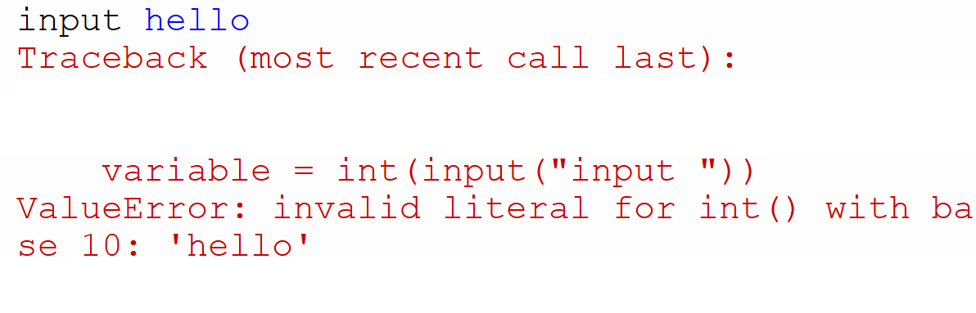
Example

Slide 19
Example
What will happen if we write: 10

Slide 20
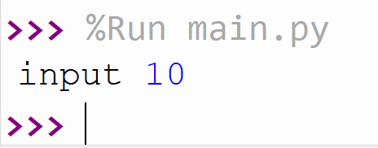
Example

Slide 21
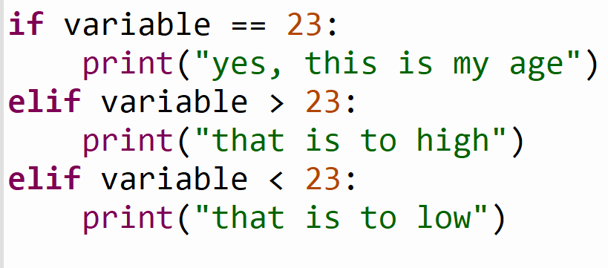
Example
What will the elif do?

Slide 22
Calculator 25 min
What do we need to build a calculator?
2 numbers
An operator (+, -, /, *)
An output

Slide 23
Calculator
What do we use from our Python knowledge?
print()
input()
variables
if & elif & else
int()
while() (optional)

Slide 24
Assignment build the calculator (25 min)
There are 3 inputs, 2 numbers and 1 operator(+, -, *, /)
Check the inputs on one of the inputs.
print the result like this: (1 + 1 = 2) or (2 * 2 = 4)
Optional:
Use the while loop
Extend it with square and/or root (google this)

Slide 25
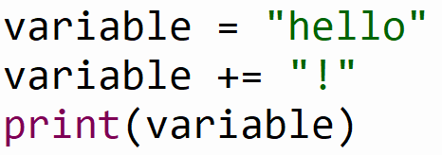
Example
What will the += do?

Slide 26
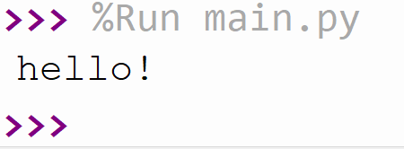
Example

Slide 27
Example
What will the += do?

Slide 28
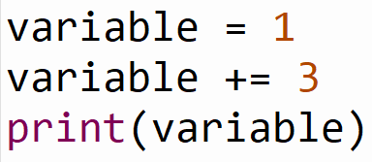
Example
What will the += do?

Slide 29
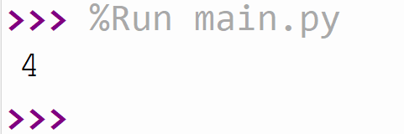
Example

Slide 30
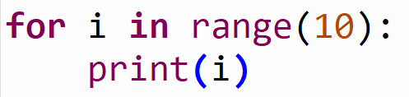
Example
What do you think this will do?

Slide 31
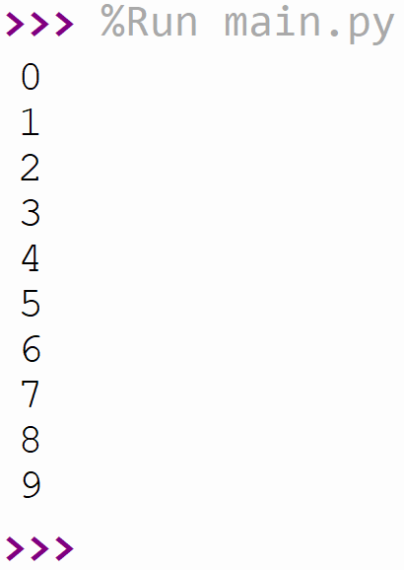
Example
A loop from 0 to 10

Slide 32
Assignment triangular number (20 min)
This assignment is the same as the previous but now you need to figure something out yourself.
Create a for loop that goes from 1 until the number given by the user.
So if the user gives 5 as in input the result must be:
1 + 2 + 3 + 4 + 5 = 15
15 should be printed

Slide 33
Arrays

Slide 34
Example
What is in the variable?

Slide 35
Example
This is a Array of numbers.
variable has multiple values.

Slide 36
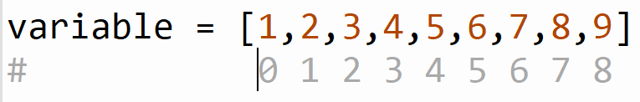
Example
1 is the first item of the array with the index of 0
2 is the second item of the array with the index of 1

Slide 37
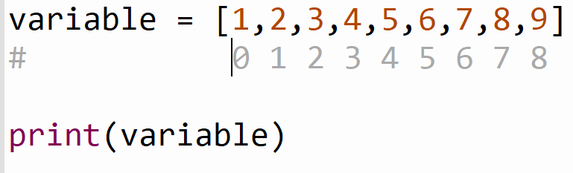
Example
What will happen if we print this?

Slide 38
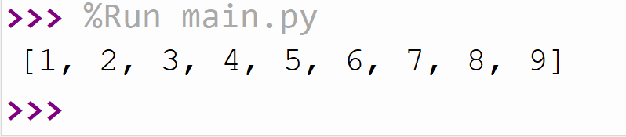
Example
It will print the whole array

Slide 39
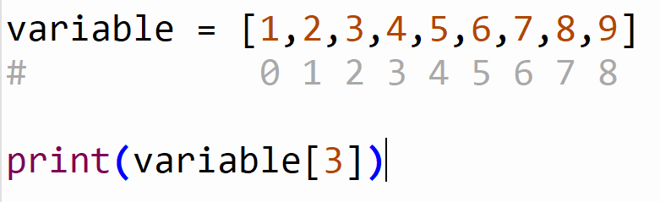
Example
What will happen if we print this?

Slide 40
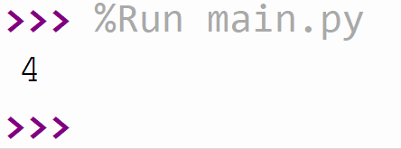
Example

Slide 41
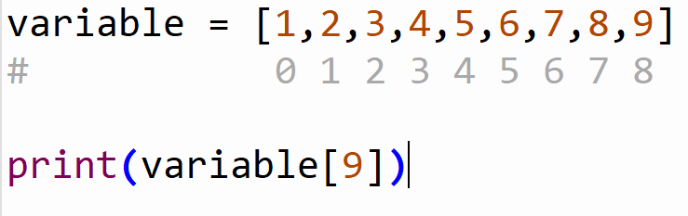
Example
What will happen if we print this?

Slide 42
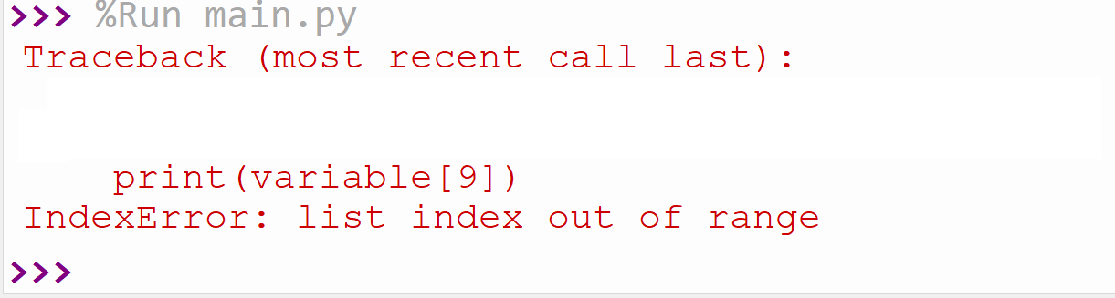
Example

Slide 43
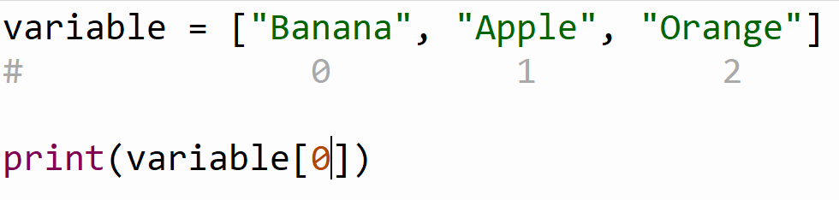
Example
What will happen if we print this?

Slide 44
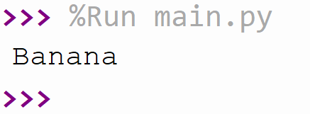
Example

Slide 45
Assignment (15 min)
Google how to loop through the array in Python
print the items in the loop one by one

Slide 46
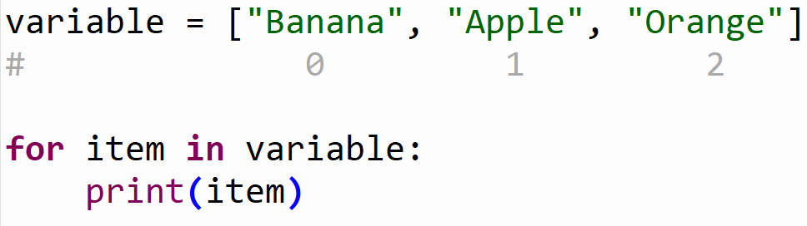
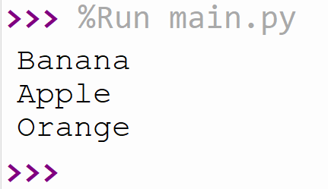
Assignment (15 min)

Slide 47
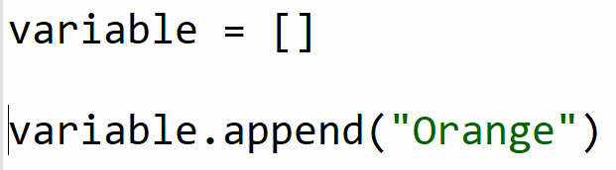
Example
What do you think the append function will do?

Slide 48
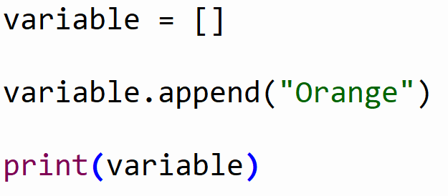
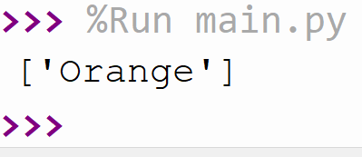
Example

Slide 49
Assignment Fibonacci (25 min)
Ask the user how long the array should be (input)
Check the input of the user
If it is 0 the result should be []
If it is 1 the result should be [1]
If it is 2 the result should be [1, 1]
Else it should be a list of the length of the input
The Fibonnaci seqence is a sequence of numbers where the next number in the sequence
is the sum of the previous two numbers in the sequence.
The sequence looks like this: 1, 1, 2, 3, 5, 8, 13, …)

Slide 50
Summary
Basic Python syntax: print(), input(), int(), while(), for()
If, elif & else
Arrays, with numbers and strings
Build a calculator, Triangular number, build a for with an array

